Slide 1
Final report on Traffic Alert Research
Zheng Wei
Sep 2018
©2017 PayPal Inc. Confidential and proprietary.
Notes:
Hi Janice, hi everyone, the theme of my summer project is traffic alert research

Slide 2
Project Overview
Background
Workflow
Focus & Study
Summary
Plan
Notes:
I will introduce the project from the following aspects: background, workflow, focus&study, summary and plan.

Slide 3
Background
Transactions with tags
All attempts
Declined by frontend Models(CAM, ATOM…)
Var & bad rate
New attribute
Alert
Based on merchants
Notes:
Now let‘s first look at the background. As we all know, we have thousands of transactions in PayPal all the time, then these transactions will be first declined by frontend models, so we can get a lot of transaction information they have good or bad tags. And from the perspective of merchant, each merchant will accumulate a lot of transaction information with tags, that is, transaction information with bad rate. And our frontend model is based on transaction level, so these models tend to ignore the variables that can be extracted based on the merchant angle. So the focus of my project is to explore some variables that can be associated with bad rate or under attacked. And Based on the merchant, we can use the variable to feed back the frontend model. We can also do some alert related content to the attempts.

Slide 4
Background
Transactions with tags
All attempts
Declined by frontend Models(CAM, ATOM…)
Var & bad rate
New attribute
Alert
Based on merchants

Slide 5
Workflow
Variables
(Categorical, Continuous)
Design Statistics
New attributes
TPV
Suc_num
USD_amt
Model_score
Sndr_days_on_file
Sndr_IP4
Sndr_country
……
Distinct Number
Proportion shift
Top percentile
Velocity change
Average
Sum
……
Bias rank
Gap rank
Correlation
Complex statistic
……
Notes:
Okay, let‘s take a look at the workflow. The process is probably like this. We can get a series of Variables from the data accumulated by the merchant. Then we can get a series of statistics based on these Variables, and find some relationship between these statistics and bad rate. Of course, sometimes these statistics do not relate to the bad rate. We may need to further construct some Variables based on these statistics such as bias rank, gap rank and etcetera

Slide 6
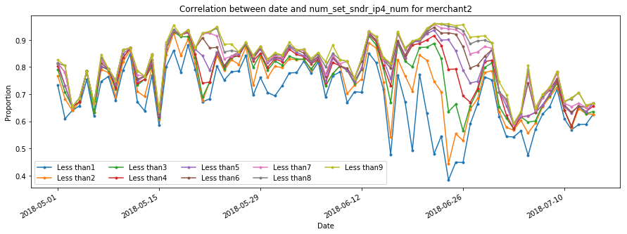
Workflow
Correlation between date and Sndr_days_on_file
Notes:
Then, all three figures are based on a merchant‘s information. The first thing we already know is that the time period marked in red in the figure represents that this merchant was under attacked during this time. Then let’s take a look at some of the performance of Variable. In the top left picture, the three lines represent the number of successful transactions, the successful and marked as good, and the number of the declined. We can see that these three Variables have a steep rise during this time, which can be related to the attack of this merchant. Then we can look at the picture on the right. We can find out that the score given by the cam model is reduced during the period when the merchant is under attacked, which means that the cam model did not perform well in this case. The bottom line depicts a performance of the sndr_days_on_file at different times of the gap‘s proportion. Sndr_days_on_file refers to the gap from the date of account registration to the time when the transaction occurred. The horizontal axis is the date, and the vertical axis is the proportion. The nine lines in the figure refer to gap less than one, and less than two , and so on. it is less than nine. Then we can know that the bottom line obviously means less than one, and the share is the lowest, and the highest is less than nine. We see that during this period of time when the merchant was under attacked, the gap between the shares of different registration times was significantly larger than the average. So this is a variable related to under attacked.

Slide 7
Focus
sndr_ip4_num
sndr_country
Distinct number
Bad Rate
Under Attacked
Alert
Distinct number
Proportion shift
Notes:
Okay, this time we mainly discuss the two variables. They are sender IP and sender country. We mainly look at their distinct number and proportion shift. Then look for the relationship between these statistics and the bad rate under attacked or the info related to alert.

Slide 8
Study
FROM pp_risk_ops_views.unified_dataset_v3 t2
inner join pp_risk_roe_views.seller_seg_bu_his_temp seg
on t2.rcvr_id = seg.cust_id
and seg.SEG = 'Commercial’
and t2.pmt_start_date between '2018-04-01' and '2018-04-30'
SQL:
Dataset info:
RCVR_ID: 634, 252
Transaction: 568, 058, 495
pmt_start_date:
2018/04/01 ~ 2018/04/30
Notes:
let's take a look at the data set. We selected the data set from April 1 to April 30 this year. A total of more than 630,000 rcvr_id, and more than 500 million transactions

Slide 9
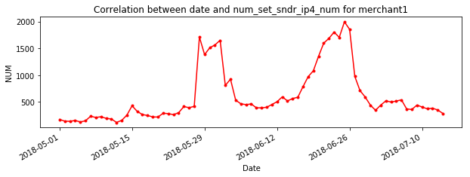
Study distinct number of sndr_ip4_num
DN_shift: (DN – his_avg_DN) / his_avg_DN
BR_shift: (BR – his_avg_BR) / his_avg_BR
Sliding window
Notes:
Let‘s first look at the case of the distinct number of sender IP.The picture on the left still corresponds to the previous merchant. We can find that it has a steep rise in its distinct number of sender IP during the period of attack, then at the overall level,is there also the good performance of this Variable? We can look at the picture on the right. The two curves represent the average of the more than 600,000 merchants per day and the average of the bad rate.From this picture alone, we can't find any obvious relationship between these two quantities. Especially in the section marked with red in the figure, where the bad rate shifts, the distinct number is changing in the opposite direction. For a more in-depth study, we introduce two new statistics, which are distinct number shift and bad rate shift. They are calculated by subtracting the historical mean from the value of the day and dividing by the historical mean. In other words, we are calculating a year-on-year change. Then the calculation of this historical mean, we take the average of the data from the previous month from the day as his historical mean. In other words, we select a sliding window for each value to calculate.

Slide 10

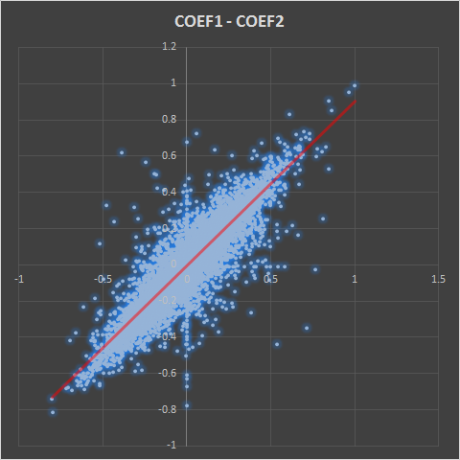
Study distinct number of sndr_ip4_num
person correlation coefficient
COEF | BR_DN | BR_DN(shift)
+ | 5777 | 5766
- | 6701 | 6799
AVG | -0.013 | -0.016
COEF2 > 0.6: 46
avg tot_num: 4717.5 ( > 944.7)
COEF2 < - 0.6: 28
avg tot_num: 16436 ( >> 944.7)
Notes:
Okay，那这里，我们还需要介绍一下皮尔逊相关系数的概念。这是用来描述两个变量变化的一致性的量。如果两个Variable的相关系数越大，那说明他们的相关性越大。反之则越小。相关系数的值域是【-1，1】。如果这个值趋近与0，说明两个Variable并没有什么关系。那下面我们看一下这个统计表格。这统计了bad rate 和distinct number 还有它们各自的shift的关系。为了使研究的数据更有代表性，我们对RCVR_ID做了筛选。我们选出TPV比较大并且历史数据比较健全的一些rcvr_ID。一共有一万多个。那么这里两个相关系数是正数的都比是负数的少了1000左右。并且他们的均值都是一个比较小的负数，呈现微弱的负相关的关系。我们看下右边这张图，这是描述两个相关系数之间的关系。我们发现几乎可以用一条y=x的直线来拟合这个散点图，所以这说明在研究价值上，有没有shift其实都是一样的。然后我们再来看一下相关系数比较大的merchant的情况。相关系数超过0.6的有46个merchant，相关系数低于-0.6的，一共有28个merchant。并且这些merchant的每天平均的交易量都大于所有merchant的平均值。所以我们可以说，distinct number 和bad rate呈现比较强的相关性的merchant 大概率是large merchant，而反过来，large merchant不一定会呈现出比较强的相关性。

Slide 11
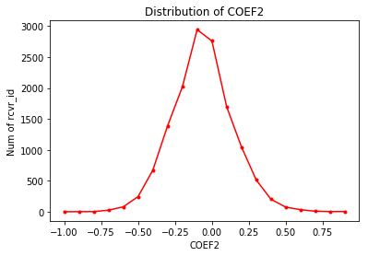
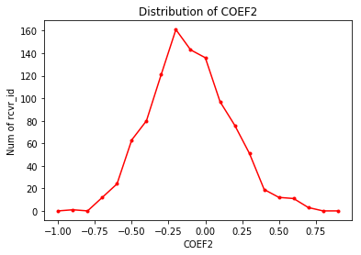
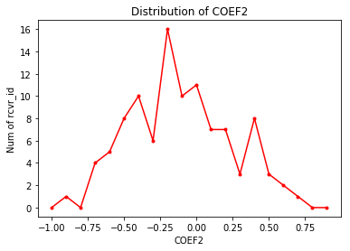
Study distinct number of sndr_ip4_num
Totally
close to standard normal distribution
Top 1000
close to normal distribution
with a mean of -0.2
Top 100
Notes:
Okay，我们来看一下这个相关系数的总体分布。Overall，相关系数接近于是标准正态分布，这说明distinct number of sender IP这个Variable并不是在所有merchant都有好的表现。而在top TPV的层面上，我们可以看到相关系数的分布接近均值为-0.2的一个正态分布。

Slide 12
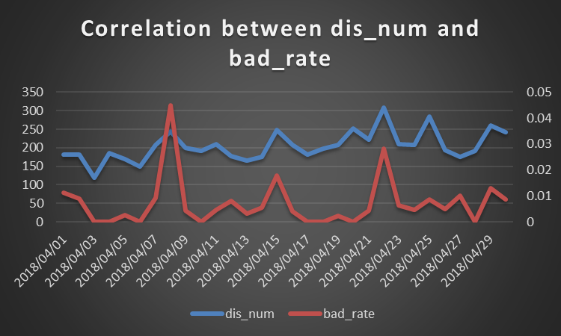
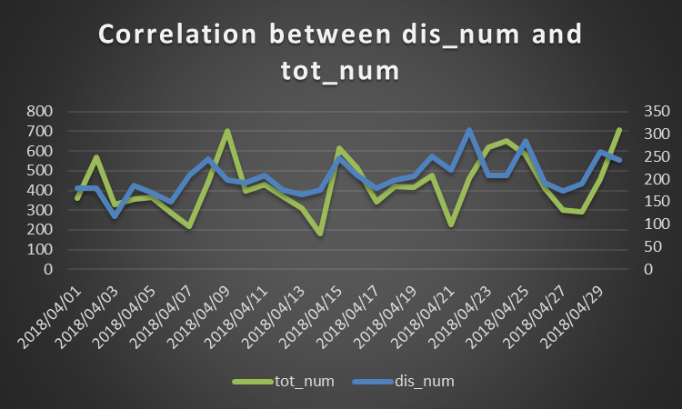
Study distinct number of sndr_ip4_num
A large merchant (id: 2107515622657774954)
Notes:
好的，那现在让我们分别看一下正相关和负相关的top case.这是正相关的。左图蓝色的折线代表distinct number，and 红色的折线代表bad rate。右图蓝色依然是distinct number，而绿色是tot_num。通过左图我们可以看到在bad rate突然升高的情况下，往往伴随着distinct number也在升高。而通过右图我们可以发现，distinct number升高往往伴随着tot_num的升高。这样的情况往往是这个merchant新增加的交易中，有更多的坏的交易，导致bad rate升高。

Slide 13
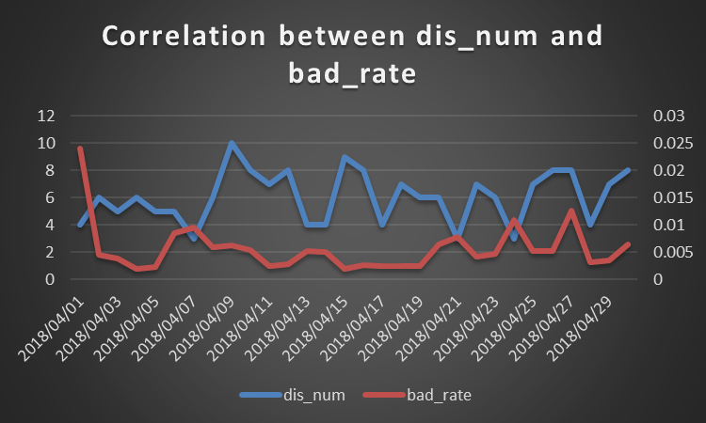
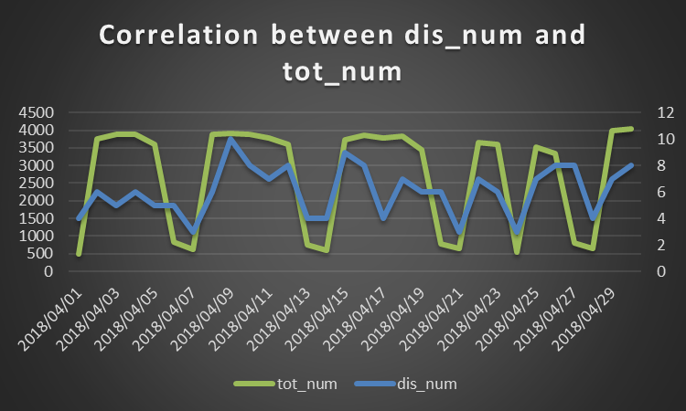
Study distinct number of sndr_ip4_num
A large merchant (id: 2172380242254638677)
Notes:
然后这是负相关的一个case。我们可以看到在bad rate升高的地方，往往distinct number 都是降低的。而同时也伴随着tot_num的降低。在看了很多类似的case，我们发现主要是由于减少的交易中大都是好的交易，所以导致bad rate相对下上升。

Slide 14
Study distinct number of sndr_ip4_num
Conclusion
Correlation with bad rate depends on merchant
COEF’s distribution
Close to standard normal distribution totally
Close to normal distribution with a mean of -0.2 on merchants with large TPV
The negative correlation is mainly caused by inconsistencies of growth between
TPV and the bad.
Notes:
Okay 让我们总结一下关于distinct number of sender IP的结论
首先 我们知道distinct number和bad rate 的相关性取决于merchants。
第二，如刚刚所说，我们可以得到distinct number和bad rate 分布的信息
最后，我们可以对一些merchant的趋势进行解释

Slide 15
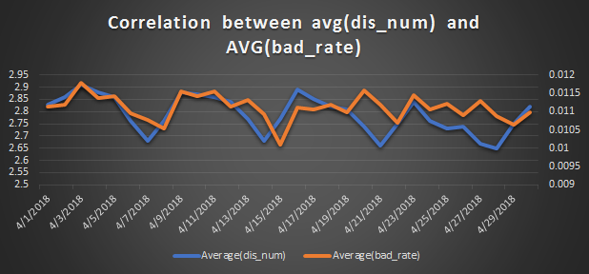
Study distinct number of sndr_country
Totally:
Dataset info:
RCVR_ID: 63, 4252
Transaction: 568, 058, 495
pmt_start_date:
2018/04/01 ~ 2018/04/30
Notes:
Okay，现在我们来看下sender country的distinct number的相关信息。那么研究这个的framework和研究sender IP的framework大致一样。我们使用了同样的数据集。首先看下overall的表现。这张图的两条折线分别是average的distinct number和average的bad rate。我们可以看到在某些时间段上，他们的变化是一致的，比如在图中蓝色标出的那一段。那，下面我们具体到merchant的层面上，来看一下相关性的信息

Slide 16
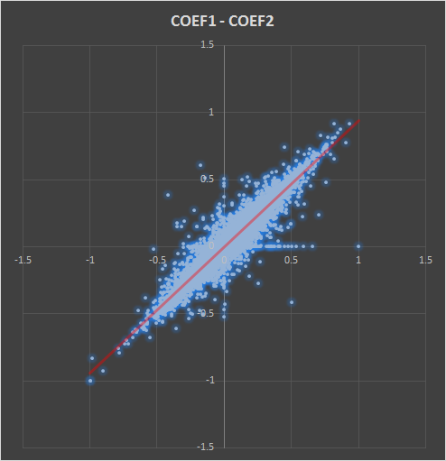
Study distinct number of sndr_country
COEF | BR_DN | BR_DN(shift)
+ | 6773 | 6651
- | 5769 | 5815
AVG | 0.02482 | 0.02183
Notes:
和刚刚sender IP表现不同的是，sender country正相关的rcvr_id的数量比负相关的多出了1000左右，且总体平均的avg相关系数在0.02左右，呈现出微弱的正相关。

Slide 17
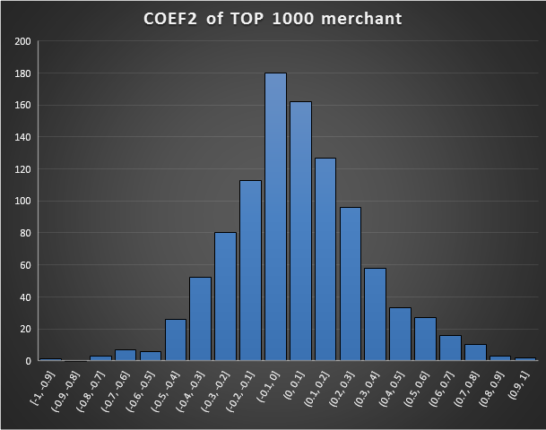
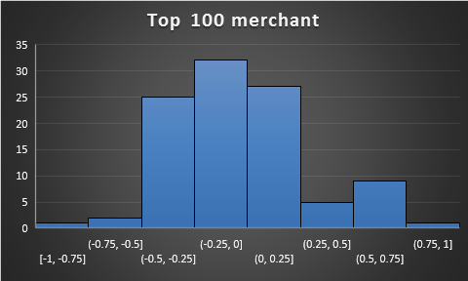
Study distinct number of sndr_country
Notes:
我们从top TPV 的merchant角度来看相关系数的分布。在top1000的rcvr_id上，分布很接近标准正态分布，但是在top100 的rcvr_id上，我们可以看到相关系数处在-0.5~-0.25这个区间内的rcvr_id的数量占到了四分之一。

Slide 18
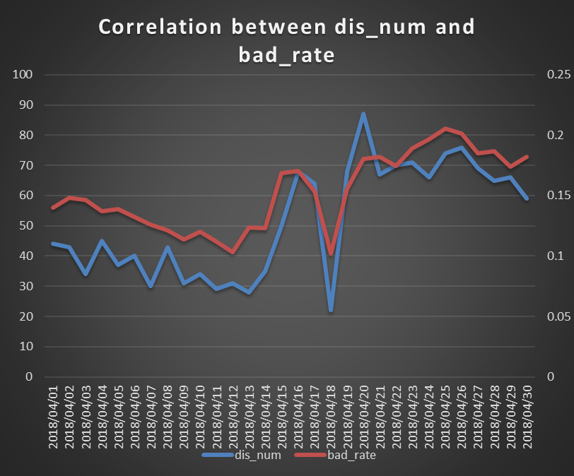
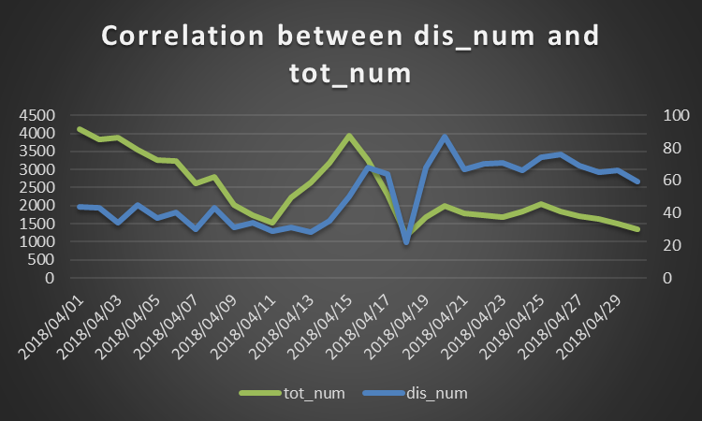
Study distinct number of sndr_country
A large merchant(id: 1363174192714401239)
Notes:
同样，我们选出两个top case来看。首先是正相关的merchant。我们可以看到在bad rate发生明显shift的情况下，distinct number也发生了明显的shift。并且伴随的tot_num 是同步变化的。

Slide 19
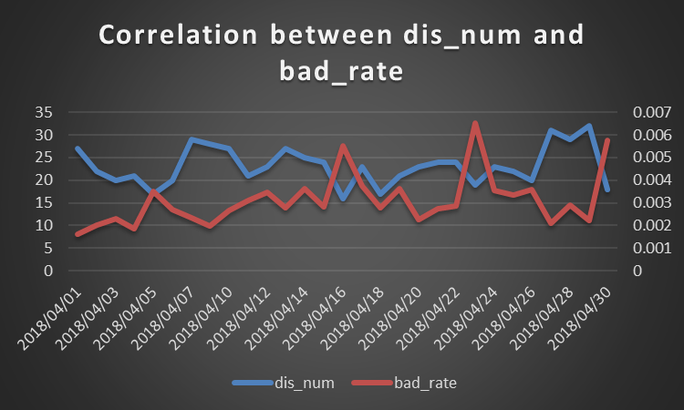
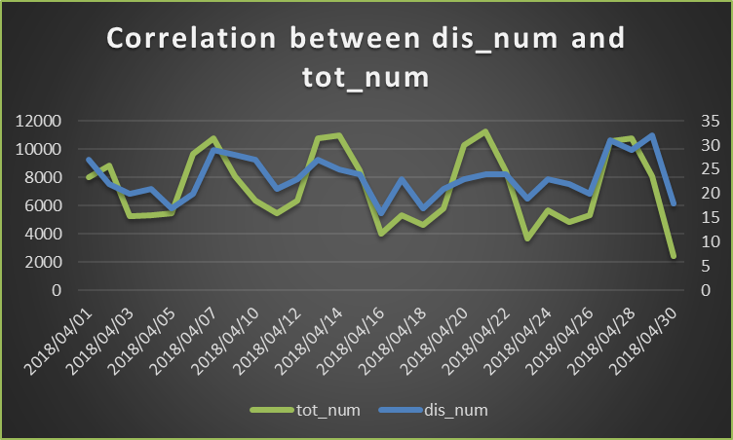
Study distinct number of sndr_country
A large merchant(id: 1531398633589183775)
Notes:
再看一下负相关的例子，与sender IP类似，在bad rate升高的情况下，distinct number会降低 且会伴随着tot_num 的降低。原因也依然主要是由减少的交易中主要是好的交易导致。

Slide 20

Study Proportion shift of sndr_country
Ordered by tot_num
Original dataset
Top 1000 merchant
& daily trans $≥$ 1000
RCVR_ID: 1000
Transaction:29936
pmt_start_date:
2018/04/01 ~ 2018/04/30
Dataset info:
Notes:
Okay 接下来我们看最后一个Variable，proportion shift of sndr_country。为了研究的数据更有代表性并且考虑到计算时间的问题，我们挑选了1000个top merchant，它们的日交易量都超过了1000。那么数据集缩至一千个rcvr_Id 并且具有3万个左右的transaction。Pmt_start_date还是没变。

Slide 21
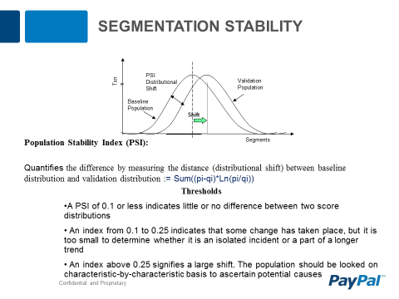
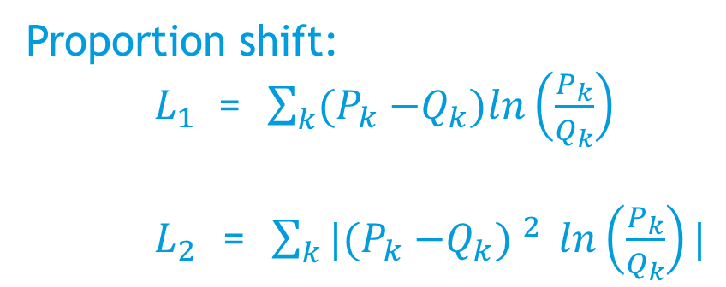
Study Proportion shift of sndr_country
For a merchant:
Country | Time P | Time Q
A | 20% | 30%
B | 30% | 40%
C | 40% | 10%
D | 10% | 20%
Proportion shift:
$L_{1}$ = $\sum_{k}{{(P}_{k} −Q_{k}})ln\left(\frac{P_{k}}{Q_{k}}\right)$
$L_{2}$ = $\sum_{k}{|{(P}_{k} −Q_{k}) ^{2}} ln\left(\frac{P_{k}}{Q_{k}}\right)|$
Notes:
对于proportion shift of sndr_country，我们参考PSI，一个描述distribution shift的指标来构造描述proportion shift的指标，如右下的L1和L2。我们可以把merchant一个时刻不同国家所占份额的信息看成是一个向量。那么proportion shift就相当于是在计算不同时刻的距离再配上一个变化的权重，也就是后面乘上的对数项。

Slide 22
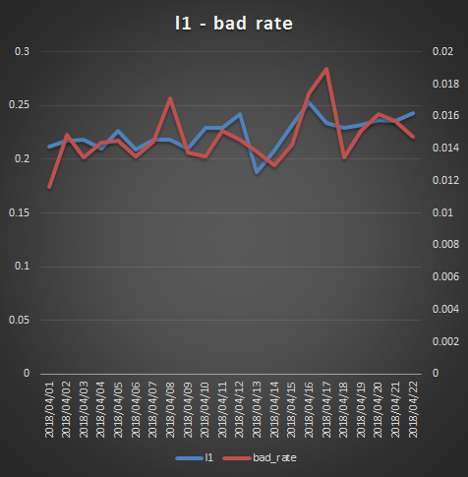

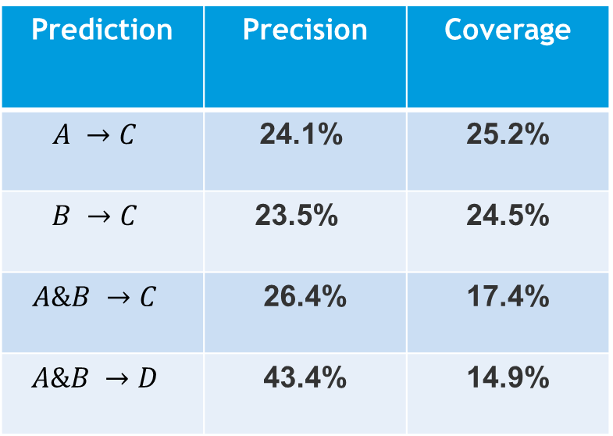
Study Proportion shift of sndr_country
A: l1_pos is less than or equal to 5 (5627)
B: l2_pos is less than or equal to 5 (5627)
C: bd_pos is less than or equal to 5 (5382)
D: bd_pos is less than or equal to 10 (10336)
A & B: 3533
Shift of L1(2) predicting shift of bad_rate
$L_{p}$ Bias Rank:
1
Prediction | Precision | Coverage
$$A →C$$ | 24.1% | 25.2%
$$B →C$$ | 23.5% | 24.5%
$$A\&B →C$$ | 26.4% | 17.4%
$$A\&B →D$$ | 43.4% | 14.9%
Notes:
然后我们主要是想利用L1和L2的shift去预测bad rate 的shift。我们create一个名为bias rank的指标。这个指标是指在一段时间内，当前时刻离均值的远离程度的排名。比如下图所示，对于红色折线bad rate，红色的水平线是它的均值，那么图中标1的地方显然是离均值最远的地方，所以它的rank也最高是1。对于其他的指标以此类推。然后我们看一下右上所示的四个事件，A是代表L1的rank在前5的交易数。依次类推B，C，D。然后我们可以得到下面的evaluation matrix。比如对第一行，表示当L1的rank在前5，bad_rate 在前5的precision和coverage。precision的计算是A&C除以A，coverage的计算是A&C除以C。所以由第一行出发，我们可以得到的结论是，当L1发生的shift的rank是当月前五的情况下，bad rate 发生shift的rank有24.1%的概率也是在前五。其他行的结论以此类推。

Slide 23

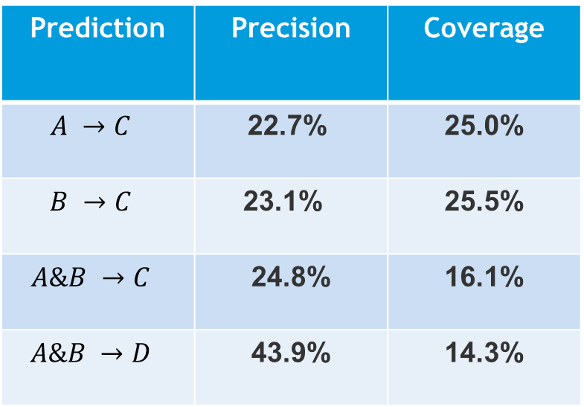
Study Proportion shift of sndr_country
A: l1_pos is less than or equal to 5 (5598)
B: l2_pos is less than or equal to 5 (5598)
C: bd_pos is less than or equal to 5 (5078)
D: bd_pos is less than or equal to 10 (10093)
A & B: 3281
$L_{p}$ Gap Rank:
1
Prediction | Precision | Coverage
$$A →C$$ | 22.7% | 25.0%
$$B →C$$ | 23.1% | 25.5%
$$A\&B →C$$ | 24.8% | 16.1%
$$A\&B →D$$ | 43.9% | 14.3%
Notes:
这是一个类似的指标：Gap rank。与bias不同的是，这主要是来比较当天与前后天的gap的绝对值之和的rank。所以同样一张图，rank为1 的位置也相应发生了变化，图中的rank为1的位置代表他和邻居们的gap最大。然后也可以得到一系列类似的指标。

Slide 24
Study sndr_country
Conclusion
Distinct number
Correlation with bad rate depends on merchant
There are more negative correlation on top 100 merchants
Proportion shift
L1 & L2 can depict the trend of bad rate in some degree but affected by tot_num
The big shift of L1 & L2 can predict the bad rate’s
Notes:
那让我们来总结一下，
对sender country的distinct number，我们的结论和sender IP的有些相似，即第一 相关性取决于merchant，第二 在top100merchant上的分布往往会是负相关。
对proportion shift of sender country，我们可以用L1和L2这两个指标的shift可以在一定程度上描述bad rate的shift，同事也证明了我们framework的有效性。

Slide 25
Summary
Make specific solution for merchants
Design a set of frameworks for similar variable analysis
Role as variable of frontend models
Explain merchant’s trend
……
Notes:
关于summary，我们有以下几点：
第一，我们可以为很多merchants制定特定的solution
第二，我们设计出了一套可以用于相似Variable analysis的framework
第三，我们提出的Variable 可以用在frontend model中
最后，我们可以通过对Variable的分析来解释merchant的变化

Slide 26
Plan
Expand the framework
Verify these feature in other different dataset
Extract more attributes
……
Notes:
至于plan，我想主要有以下几点：
分别是
and我们可以从merchant的交易信息中提取出更多的和bad rate有关的变量
等等

Slide 27
Q & A
Notes:
Okay 这是全部了，有问题吗？

Slide 28
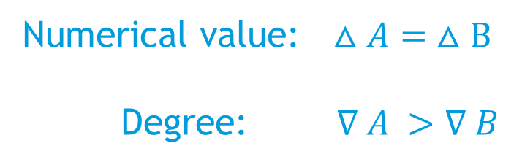
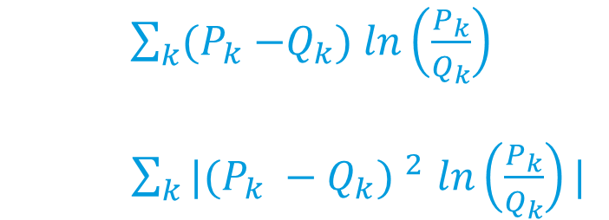
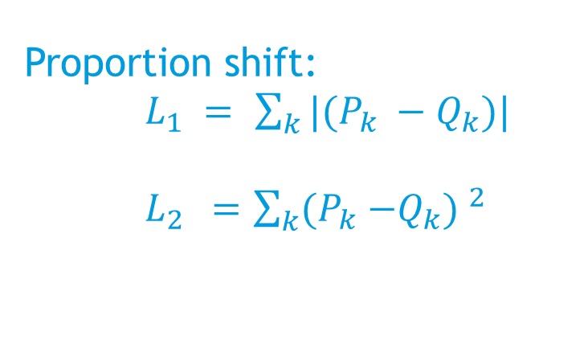
Study Proportion shift of sndr_country
Country | Time P | Time Q
A | 5% | 10%
B | 45% | 55%
… | … | …
Numerical value:$△A= △B$
Degree:$∇ A >∇ B$
Proportion shift:
$L_{1} =$ $\sum_{k}{{|(P}_{k} −Q_{k}})|$
$L_{2 } =$ $\sum_{k}{{(P}_{k} −Q_{k}) ^{2}}$
$\sum_{k}{{(P}_{k} −Q_{k}}) ln\left(\frac{P_{k}}{Q_{k}}\right)$
$\sum_{k}{{|(P}_{k} −Q_{k}) ^{2}}$ $ln\left(\frac{P_{k}}{Q_{k}}\right)|$
Plus weight

Slide 29
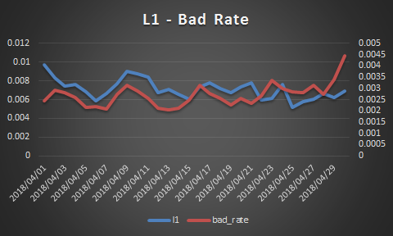
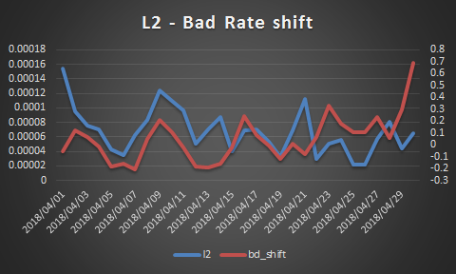
Study Proportion shift of sndr_country
A large merchant(1931414401940183232):

Slide 30
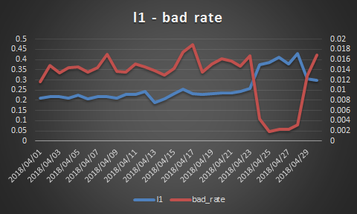
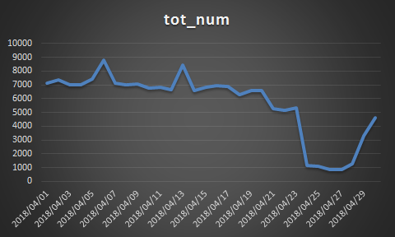
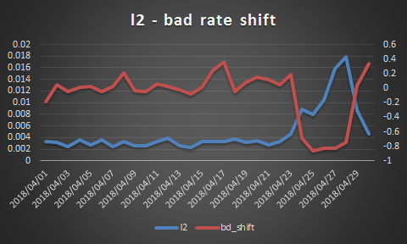
Study Proportion shift of sndr_country
A large merchant(1809909810376487672):

Slide 31
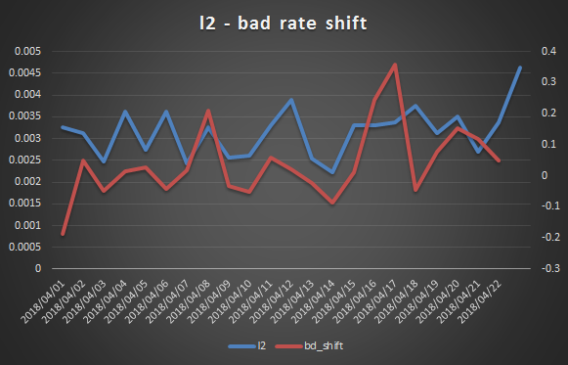
Study Proportion shift of sndr_country
A large merchant(1809909810376487672):
COEF1: 0.57
COEF2: 0.35

Slide 32

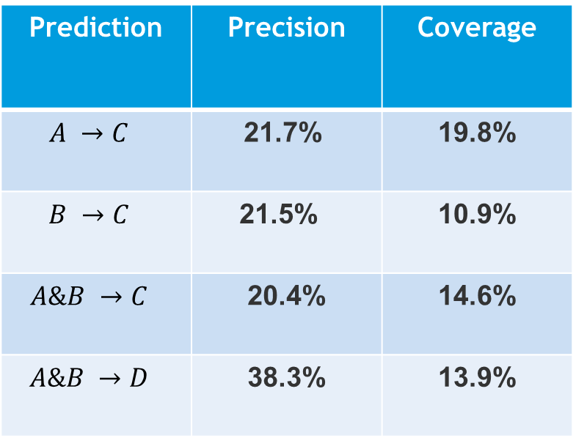
Study Proportion shift of sndr_country
Merchant: L1& L2 fitting bad rate
Model: The shift of L1 & L2 predicting the bad rate’s
$L_{p}$ Gap Rank(positive):
Prediction | Precision | Coverage
$$A →C$$ | 21.7% | 19.8%
$$B →C$$ | 21.5% | 10.9%
$$A\&B →C$$ | 20.4% | 14.6%
$$A\&B →D$$ | 38.3% | 13.9%
l1(2)_dis be difference with daily l1(2) and average l1(2)
l1(2)_pos be the top rank of sorted list containing l1(2)_dis.
A: l1_pos is less than or equal to 5 (5596)
B: l2_pos is less than or equal to 5 (5598)
C: bd_pos is less than or equal to 5 (5119)
D: bd_pos is less than or equal to 10 (10091)
A & B: 3659

